Slide 1
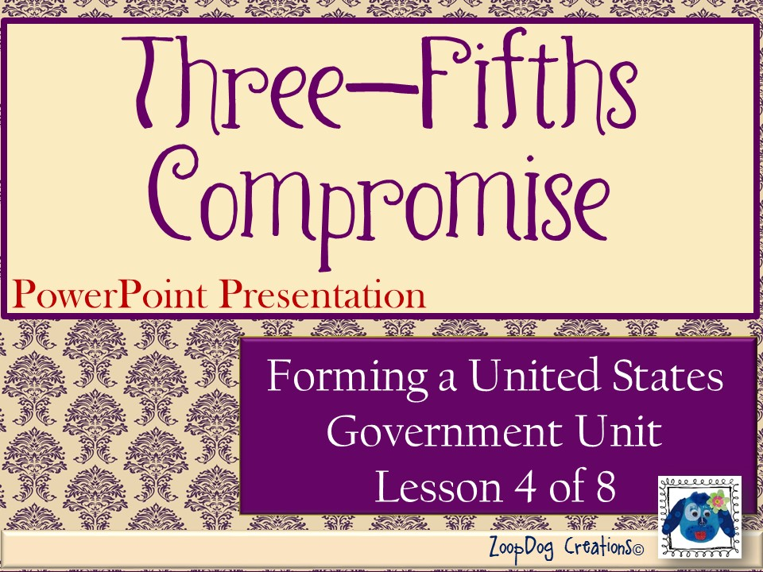

Slide 2

VOCABULARY Three-Fifths Compromise – Senate – House of Representatives –

Slide 3
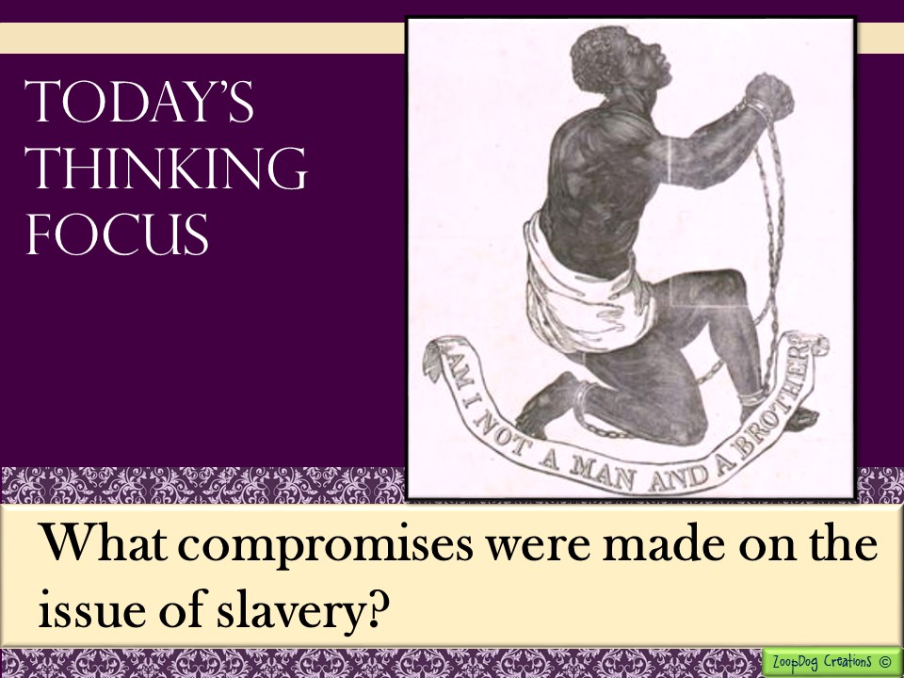

Slide 4

And the story continues . . .
The Continental Congress creates the first government - Articles of Confederation – a weak constitution!
An economic depression hits, states are fighting and the government is too weak to do anything about it!
The Continental Congress tries to create a new government, but states fight over how it should be structured.
The Virginia and New Jersey Plans are created.
The Great Compromise devised by Roger Sherman finally settles the dispute.

Slide 5

The summer of 1787, after a bitter debate, the states agreed on the structure of the government.
The United States would have three branches of government.
Two houses were formed that favored both large and small states by creating an Upper House “the Senate” and a Lower House “House of Representatives.”
Federal Government
Legislative Branch
“Congress”
- Creates and passes the laws -
Executive Branch
-Carries out the laws-
Judicial Branch
-Decides if laws are fair-
Upper House
“The Senate”
Lower House
“House of Representatives”
Regardless of population each state receives TWO representatives
Representatives are based on the state’s population.

Slide 6
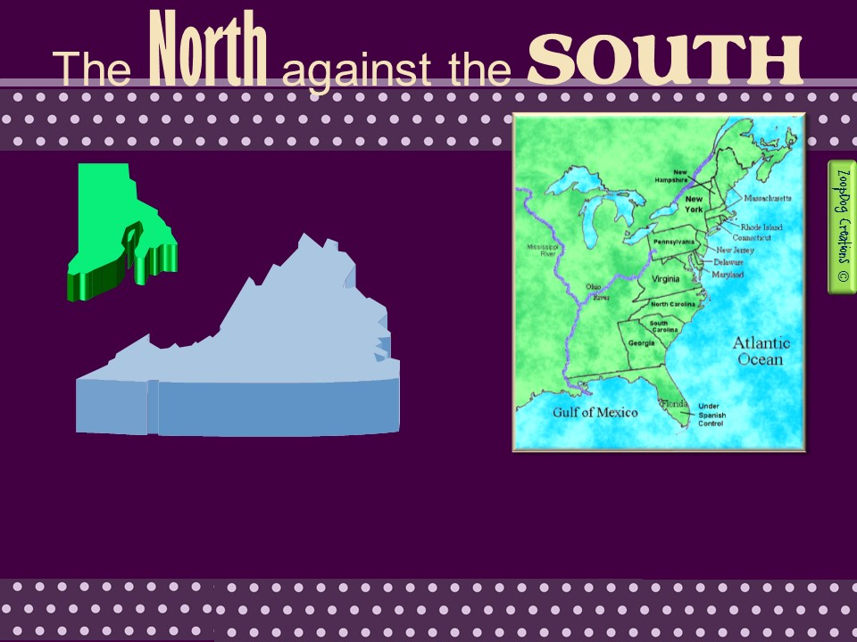
VS.
The Great Compromise, as it was called, resolved the issues between the small states and the large states.
But now another issue presented itself that pitted the northern states against the southern states.

Slide 7
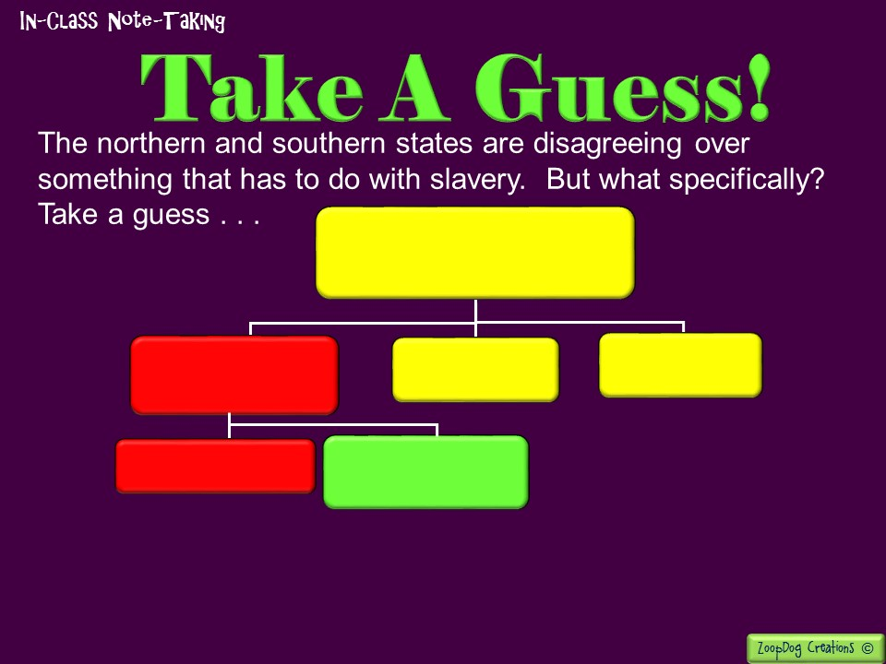
Federal Government
Legislative Branch
“Congress”
- Creates and passes the laws -
Executive Branch
- Carries out the laws -
Judicial Branch
- Decides if laws are fair -
The House of Representatives is based on state population. The states with the most people get more votes in that house. More votes = more power.
Upper House
“The Senate”
Lower House
“House of
Representatives”
Hint! More people = more votes!
But what does this have to do with slavery in the South?

Slide 8
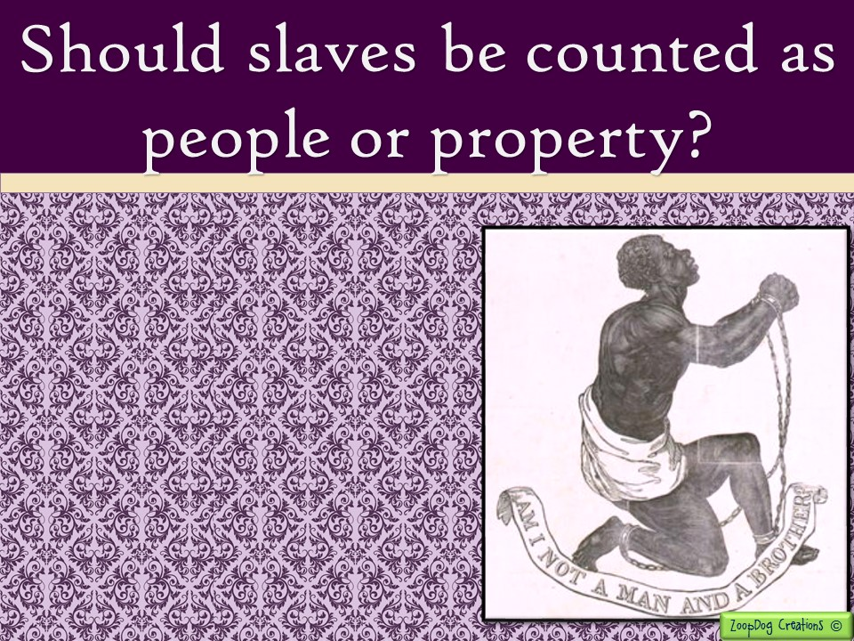
Southerners wanted to include slaves in the population count even if they would not let slaves vote.
If slaves were counted, southern states would have more representatives in the House of Representatives.
But Northerners said that slaves should not be counted since they were considered property and not people.

Slide 9

“Upon what principle is it that the slaves shall be computed in the representation? Are they men? Then make them citizens, and let them vote. Are they property? Why, then, is no other property included? The houses in this city (Philadelphia) are worth more than all the wretched slaves who cover the rice swamps of South Carolina.”
~ Gouverneur Morris, Pennsylvania Delegate
“If property be the rule of representation . . Why then should the blacks, who were property in the South, be in the rule of representation more than the Cattle and horses of the North?”
~ Elbridge Gerry, Massachusetts Delegate

Slide 10
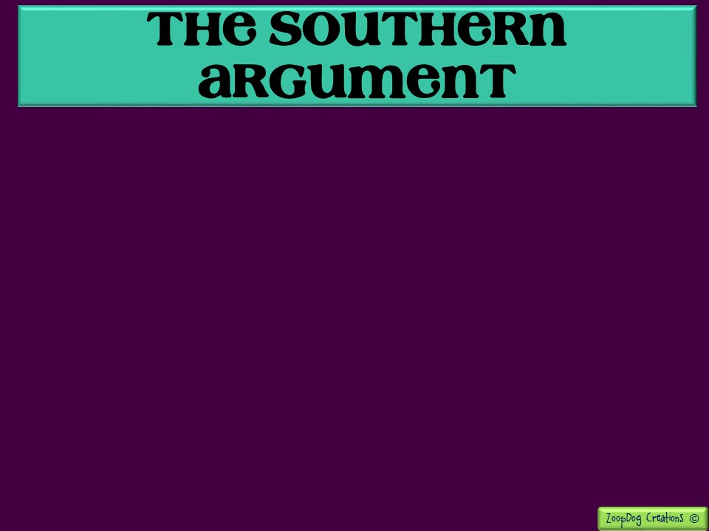
“I cannot agree to the motion, notwithstanding it is favorable to Virginia, because I think it unjust. It is certain that the slaves are valuable, as they raise the value of land, increase the exports and imports, and of course the revenue, would supply the means of feeding & supporting an army, and might in cases of emergency become themselves soldiers. As in these important respects they are useful to the community at large, they ought not to be excluded from the estimate of Representation. I cannot however regard them as equal to freemen and cannot vote for them as such. It is worthy or remark, that the Southern States have this peculiar species of property, over & above the other species of property common to all the states.”
~ George Mason, Virginia Delegate

Slide 11
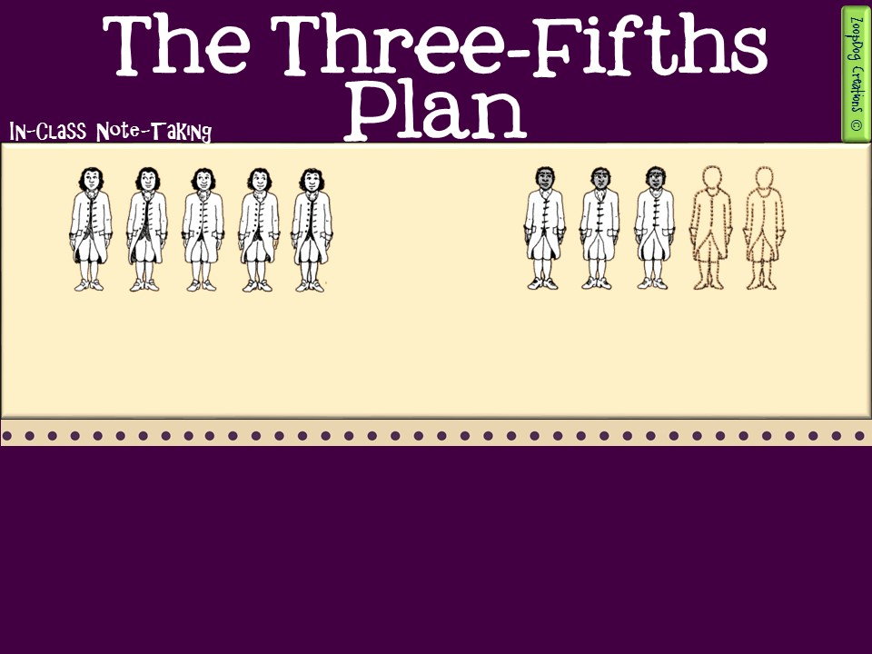
White men were counted in the population.
Three of every five black slaves were counted in the population.
Once again the delegates compromised. They agreed that 3/5 of the slaves in any state would be counted.
If a state had 5,000 slaves then 3,000 would be included in the state’s population.
This became known as the Three-Fifths Compromise.

Slide 12

In 1790, 26% of North Carolina’s population and 43% of South Carolina’s were slaves. Counting 3/5th of the slave population in these states gave North and South Carolina more representatives and thus more voting power in the House of Representatives.
The Three-fifths Compromise benefitted the southern states up until the Civil War.
More American presidents were elected from southern states than northern states. Nine of the fifteen presidents before Lincoln were southern slaveholders.
With the Supreme Court, twenty of the thirty-five justices up to 1861 were from southern states.

Slide 13
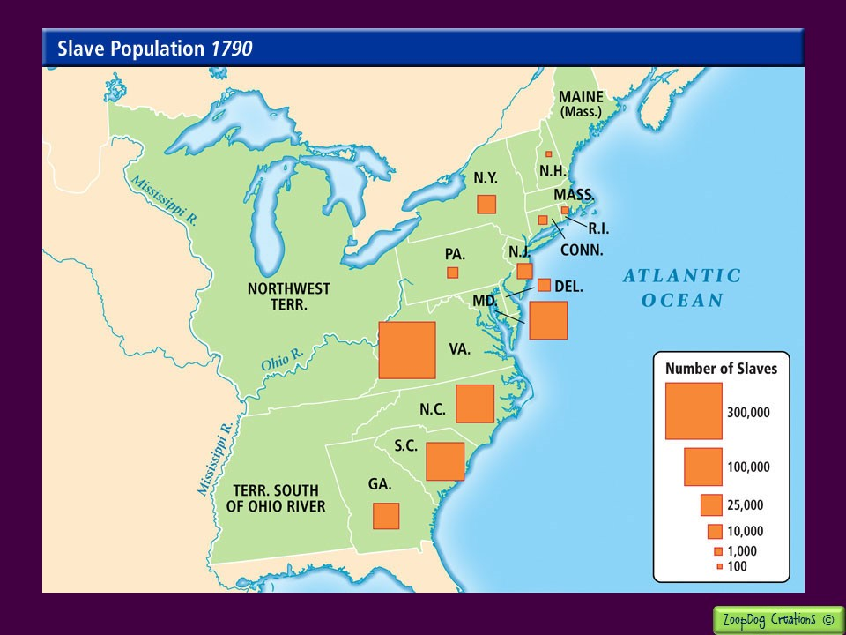

Slide 14
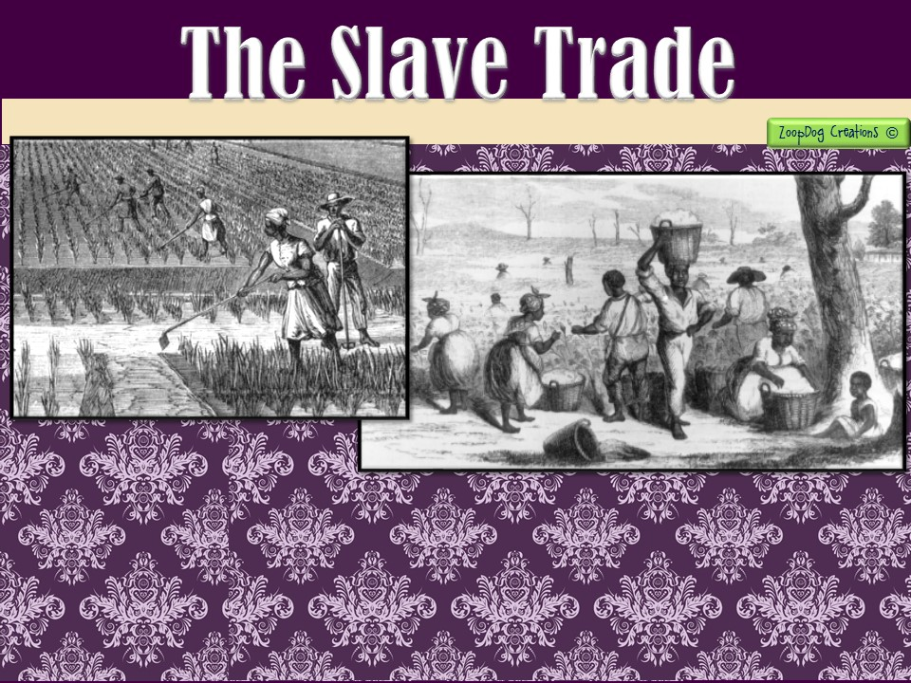
There was another disagreement over slavery. By 1787, some northern states had banned the slave trade within their borders. They urged that the slave trade be banned in the entire nation.
Southerners warned that such a ban would ruin their economy!

Slide 15
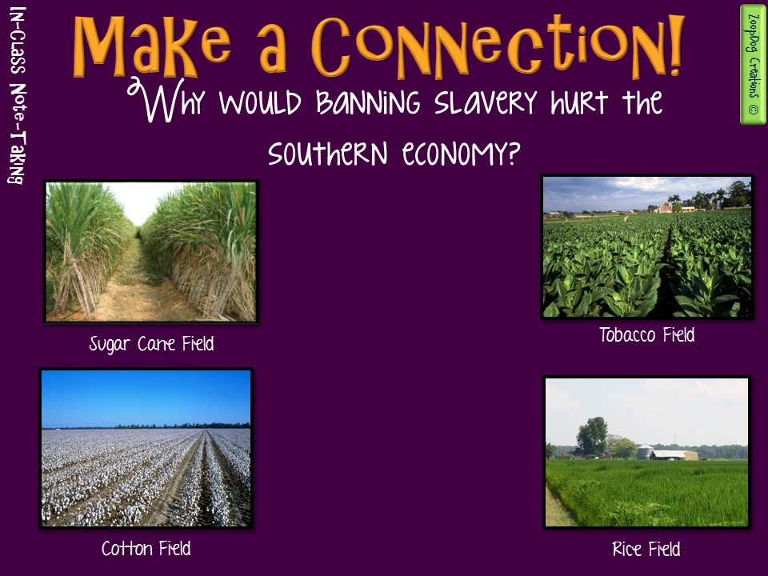
Look at the types of crops grown in the South. Why would slavery be in such high demand in the southern states?

Slide 16
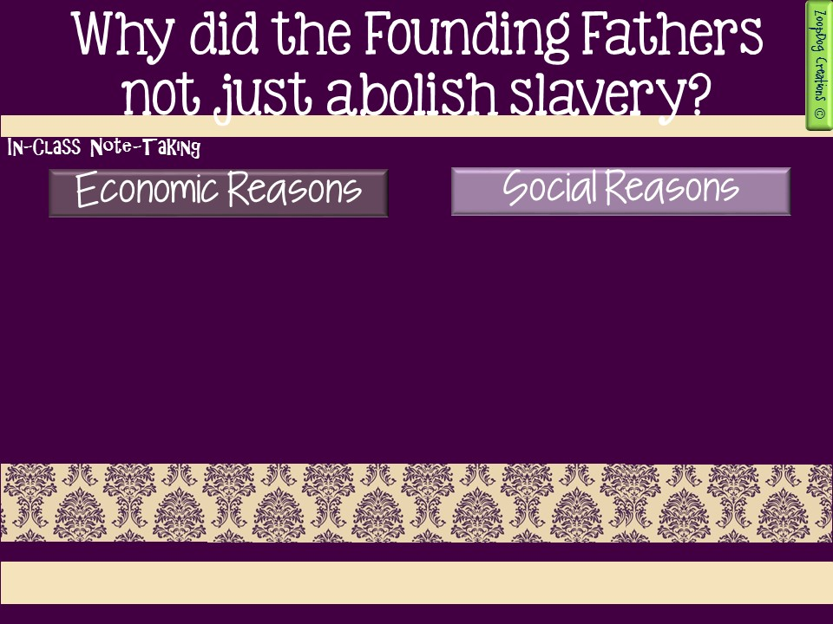
Would end a cheap labor supply. Slaves worked for free (cheap labor) harvesting and tending the southern crops which were sold around the world. Ending it would harm the southern and US economy.
Less Profit. Southern plantation owners wouldn’t make a large profit $$ if they had to pay their slaves.
Racism. Many of the Founding Fathers were slave owners themselves and had difficulty envisioning a society that included black men equal to whites.
The South threatened to leave. The southern states during tense negotiations threatened to leave the union, something the fragile new government did not want.

Slide 17
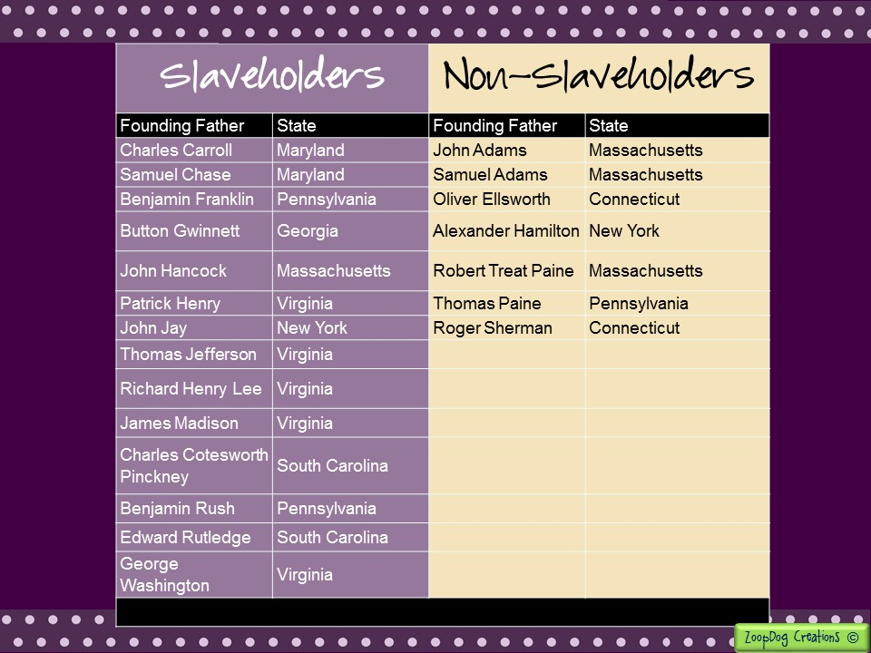

Slide 18
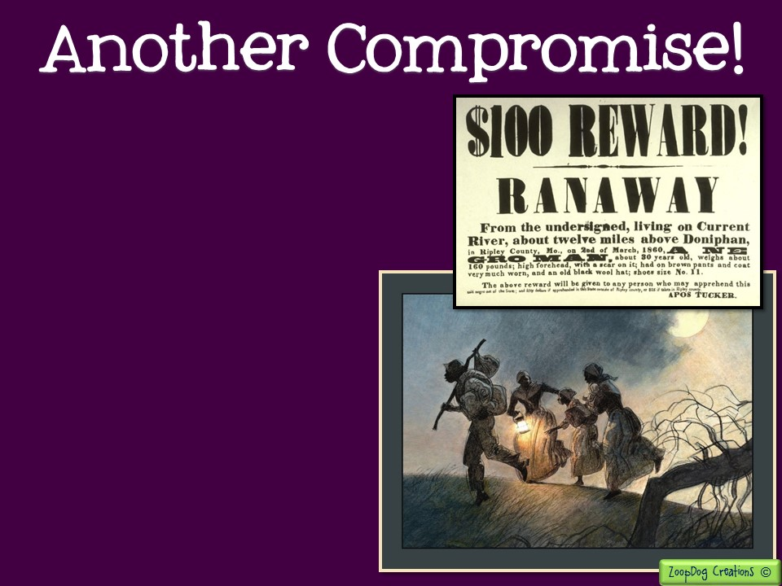
In the end, the two sides compromised once more.
  Northerners agreed that Congress could not outlaw the slave trade for at least twenty years! After that, Congress could regulate the slave trade if it wished.
  Northerners also agreed that no state could stop a fugitive (run-away) slave from being returned to an owner who claimed that slave.

Slide 19
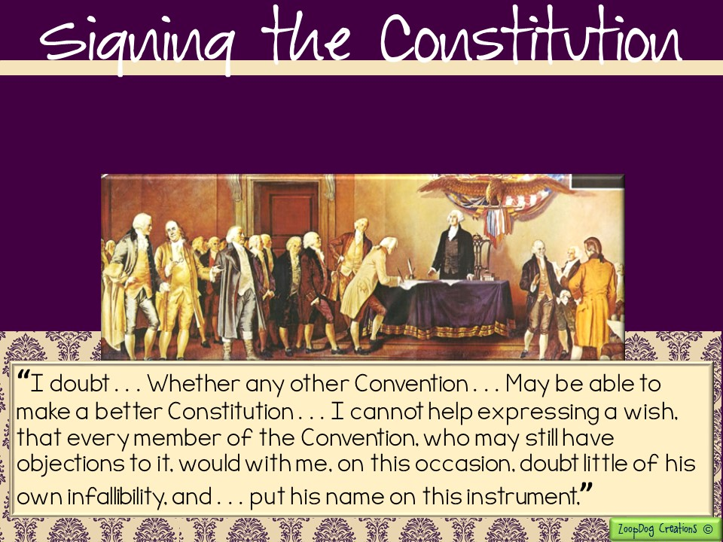
On September 17, 1787, the Constitution was ready. Gathering for the last time delegates listened quietly as Benjamin Franklin rose to plead that the document be accepted:

Slide 20
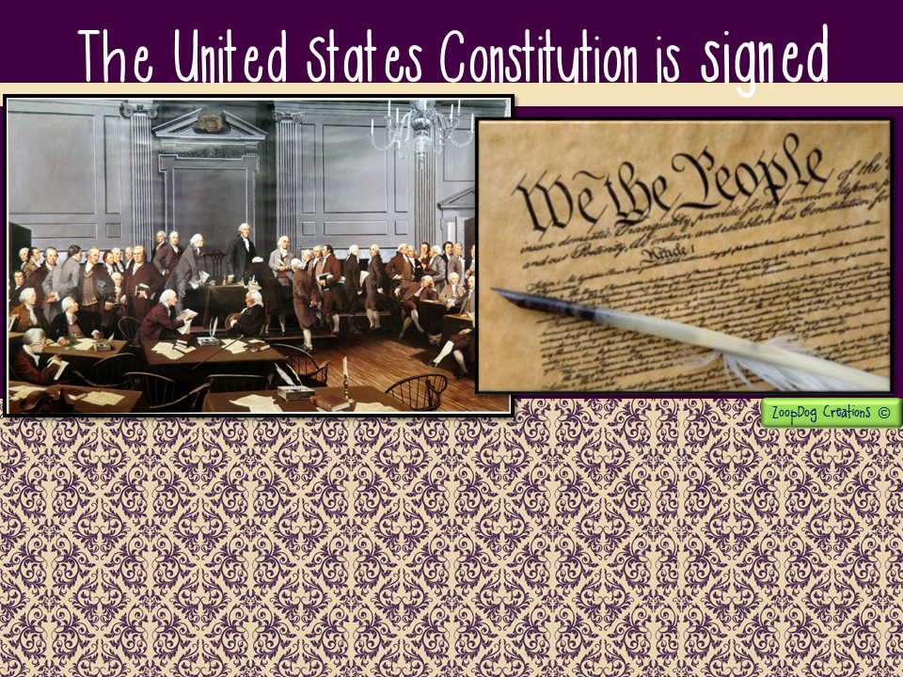
One by one, delegates came forward to sign the document. Of the 42 delegates remaining in Philadelphia, 39 signed the document.
Edmund Randolph and George Mason of Virginia, along with Elbridge Gerry of Massachusetts refused to sign. They felt the new Constitution gave too much power to the national government.

Slide 21
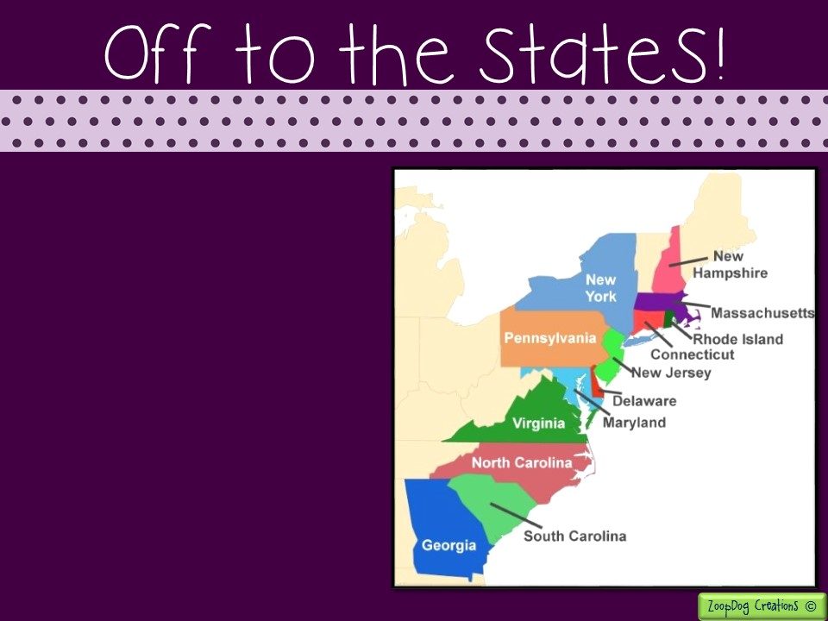
The Constitution required each state to hold a state convention to decide if the plan for the new government should be accepted.
Before that occurred, the new Constitution was discussed and debated in all the states.
Once 9 of the 13 states endorsed it, the Constitution would become the law of the land.

Slide 23


Slide 24


